Slide 1
TCP/UDP MESSAGE FORMAT -by Hitesh Nautiyal

Slide 2
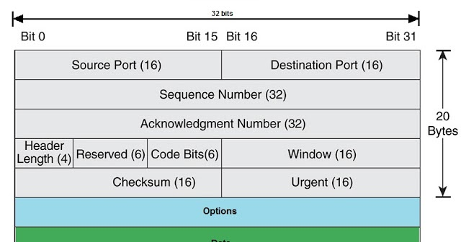
TCP Message Format :-

Slide 3
Explain TCP Message Format :-
1. Source Port-
Source Port is a 16 bit field.
It identifies the port of the sending application.
2. Destination Port-
Destination Port is a 16 bit field.
It identifies the port of the receiving application.
3. Sequence Number-
Sequence number is a 32 bit field.
TCP assigns a unique sequence number to each byte of data contained in the TCP segment.
This field contains the sequence number of the first data byte.
4. Acknowledgement Number-
Acknowledgment number is a 32 bit field.
It contains sequence number of the data byte that receiver expects to receive next from the sender.
It is always sequence number of the last received data byte incremented by 1.

Slide 4
5. Header Length-
Header length is a 4 bit field.
It contains the length of TCP header.
It helps in knowing from where the actual data begins.
Minimum and Maximum Header length-
Ques :- The length of TCP header always lies in the range-
[20 bytes , 60 bytes]
The initial 5 rows of the TCP header are always used.
So, minimum length of TCP header = 5 x 4 bytes = 20 bytes.
The size of the 6th row representing the Options field vary.
The size of Options field can go up to 40 bytes.
So, maximum length of TCP header = 20 bytes + 40 bytes = 60 bytes.
Concept of Scaling Factor-
Header length is a 4 bit field.
So, the range of decimal values that can be represented is [0, 15].
But the range of header length is [20, 60].
So, to represent the header length, we use a scaling factor of 4.

Slide 5
Header length = Header length field value x 4 bytes
Examples-
If header length field contains decimal value 5 (represented as 0101), then-
Header length = 5 x 4 = 20 bytes
If header length field contains decimal value 10 (represented as 1010), then-
Header length = 10 x 4 = 40 bytes
If header length field contains decimal value 15 (represented as 1111), then-
Header length = 15 x 4 = 60 bytes
6. Reserved Bits-
The 6 bits are reserved.
These bits are not used.
7. URG Bit-
When URG bit is set to 1,
It indicates the receiver that certain amount of data within the current segment is urgent.
Urgent data is pointed out by evaluating the urgent pointer field.
The urgent data has be prioritized.
Receiver forwards urgent data to the receiving application on a separate channel.

Slide 6
8. ACK Bit-
When ACK bit is set to 1, it indicates that acknowledgement number contained in the TCP header is valid.
For all TCP segments except request segment, ACK bit is set to 1.
Request segment is sent for connection establishment during Three Way Handshake.
9. PSH Bit-
When PSH bit is set to 1,
All the segments in the buffer are immediately pushed to the receiving application.
No wait is done for filling the entire buffer.
This makes the entire buffer to free up immediately.
10. RST Bit-
When RST bit is set to 1,
It indicates the receiver to terminate the connection immediately.
It causes both the sides to release the connection and all its resources abnormally.
The transfer of data ceases in both the directions.
It may result in the loss of data that is in transit.
This is used only when-
There are unrecoverable errors.
There is no chance of terminating the TCP connection normally.

Slide 7
11. SYN Bit-
When SYN bit is set to 1,
It indicates the receiver that the sequence number contained in the TCP header is the initial sequence number.
Request segment sent for connection establishment during Three way handshake contains SYN bit set to 1.
12. FIN Bit-
When FIN bit is set to 1,
It indicates the receiver that the sender wants to terminate the connection.
FIN segment sent for TCP Connection Termination contains FIN bit set to 1.
13. Window Size-
Window size is a 16 bit field.
It contains the size of the receiving window of the sender.
It advertises how much data (in bytes) the sender can receive without acknowledgement.
Thus, window size is used for Flow Control.
14. Checksum-
Checksum is a 16 bit field used for error control.
It verifies the integrity of data in the TCP payload.
Sender adds CRC checksum to the checksum field before sending the data.
Receiver rejects the data that fails the CRC check.

Slide 8
15. Urgent Pointer-
Urgent pointer is a 16 bit field.
It indicates how much data in the current segment counting from the first data byte is urgent.
Urgent pointer added to the sequence number indicates the end of urgent data byte.
This field is considered valid and evaluated only if the URG bit is set to 1.
16. Options-
Options field is used for several purposes.
The size of options field vary from 0 bytes to 40 bytes.
Options field is generally used for the following purposes-
Time stamp
Window size extension
Parameter negotiation
Padding

Slide 9
A. Time Stamp-
When wrap around time is less than life time of a segment,
Multiple segments having the same sequence number may appear at the receiver side.
This makes it difficult for the receiver to identify the correct segment.
If time stamp is used, it marks the age of TCP segments.
Based on the time stamp, receiver can identify the correct segment.
B. Window Size Extension-
Options field may be used to represent a window size greater than 16 bits.
Using window size field of TCP header, window size of only 16 bits can be represented.
If the receiver wants to receive more data, it can advertise its greater window size using this field.
The extra bits are then appended in Options field.
C. Parameter Negotiation-
Options field is used for parameters negotiation.
Example- During connection establishment,
Both sender and receiver have to specify their maximum segment size.
To specify maximum segment size, there is no special field.
So, they specify their maximum segment size using this field and negotiates.
D. Padding-
Addition of dummy data to fill up unused space in the transmission unit and make it conform to the standard size is called as padding.
Options field is used for padding.

Slide 10
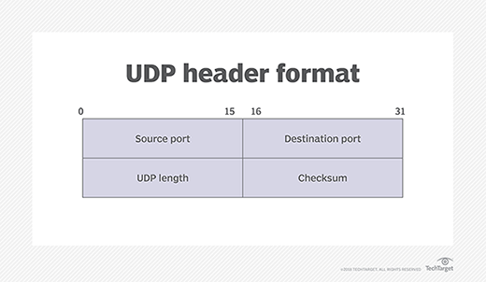
UDP Message Format :-

Slide 11
Explain UDP Message Format :-
Source Port: The 16-bit port number of the process that originated the UDP message on the source device. This will normally be an ephemeral (client) port number for a request sent by a client to a server, or a well-known/registered (server) port number for a reply sent by a server to a client.
Destination Port: The 16-bit port number of the process that is the ultimate intended recipient of the message on the destination device. This will usually be a well-known/registered (server) port number for a client request, or an ephemeral (client) port number for a server reply.
Length: The length of the entire UDP datagram, including both header and Data fields.
Checksum: An optional 16-bit checksum computed over the entire UDP datagram plus a special “pseudo header” of fields. See below for more information.
Data: The encapsulated higher-layer message to be sent.

